Slide 1

MEDIA & THE PUBLIC
Week 6 Knowledge gap & media consumption
Ryan Wang
ryanyang@psu.edu

Slide 2
BACKGROUND

Slide 3
Knowledge gap hypothesis (The Minnesota team)
Definition:
“As the infusion of mass media information into a social system increases, segments of the population with higher socioeconomic status tend to acquire this information at a faster rate than the lower-status segments, so that the gap in knowledge between these segments tends to increase rather than decrease” (Tichenor, Donohue, & Olien, 1970, pp. 159-160)
The less advantaged (e.g.: education) would gain knowledge but that the more advantaged would gain more knowledge faster
Findings:
Newspaper readership and the public affair knowledge
The slope of information uptake was significantly steeper for those with relatively higher educational attainment (such that the gap between individuals with higher and lower education widened over time)
The relationship between newspaper reading and public affairs knowledge was generally positive for all.

Slide 4
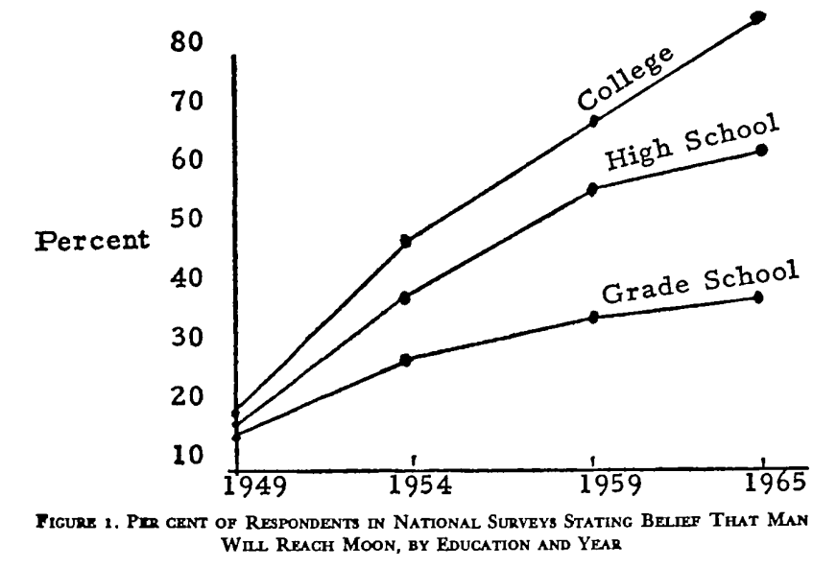
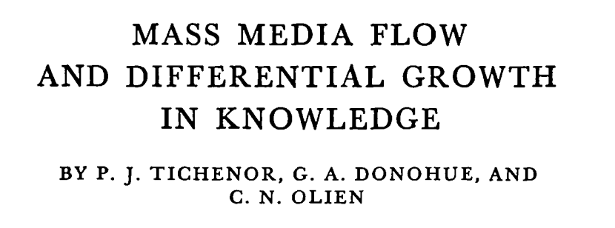
Knowledge gap hypothesis: Evidence
Notes:
They used public opinion surveys gathered between 1949 and 1965 measuring whether participants believed humans would reach the Moon in the foreseeable future. During the 15-year span, belief among grade-school educated people increased only about 25 percentage points while belief among college educated people increased more than 60 percentage points, a trend consistent with the hypothesis.

Slide 5
What is mediation?
Mediator
Motivation
a
b
c’
Aptitude
Grade
Independent variable
Dependent variable

Slide 6
What is moderation?
Moderator
Self-efficacy
Task importance
Anxiety
Independent variable
Dependent variable
Notes:
For example, academic self-efficacy (confidence in own’s ability to do well in school) moderates the relationship between task importance and the amount of test anxiety a student feels (Nie, Lau, & Liau, 2011). Specifically, students with high self-efficacy experience less anxiety on important tests than students with low self-efficacy while all students feel relatively low anxiety for less important tests. Self-efficacy is considered a moderator in this case because it interacts with task importance, creating a different effect on test anxiety at different levels of task importance.

Slide 7
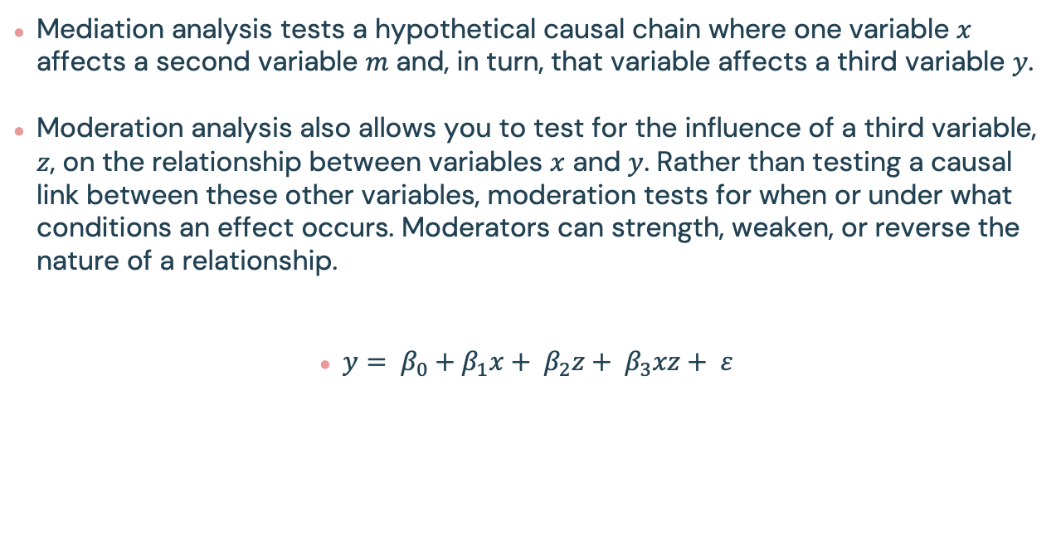
What is moderation?
Mediation analysis tests a hypothetical causal chain where one variable $x$ affects a second variable $m$ and, in turn, that variable affects a third variable $y$.
Moderation analysis also allows you to test for the influence of a third variable, $z$, on the relationship between variables $x$ and $y$. Rather than testing a causal link between these other variables, moderation tests for when or under what conditions an effect occurs. Moderators can strength, weaken, or reverse the nature of a relationship.
$y= β_{0}+β_{1}x+ β_{2}z+ β_{3}xz+ ε$
Moderation effect

Slide 8
Knowledge gap hypothesis (over time)
Moderator
Time
Level of media exposure
Knowledge gap
Independent variable
Dependent variable
Notes:
At one point in time knowledge differentials between higher and lower social segments for highly publicized subjects were expected to be relatively large, with those for less well publicized issues relatively small.
Over time the relationship between education and knowledge was predicted to increase at a greater rate for topics that received high media attention. The independent variable was level of media publicity, and the depen- dent variable was the relationship between socioeconomic status (SES) and knowledge, or the knowledge gap. If this gap is measured over time, time is a moderator variable because it influences the strength of the relationship between SES and the knowledge differential.

Slide 9
Key attributes of knowledge gap
High socioeconomic status people tends to have advantages in:
Communication skills:
reading & writing skills; learned thinking skills; speaking skills; comprehension skills
“Persons with more formal education would be expected to have the higher reading and com- prehension abilities necessary to acquire public affairs or science knowledge.” (p. 161)
Stored information
Existing knowledge resulting from prior exposure to the topics
“Persons who are already better informed are more likely to be aware of a topic when it appears in the mass media and are better prepared to understand it.” (p. 162).
Relevant social context
“High socioeconomic status people have “a greater number of reference groups, and more interpersonal contacts, which increase the likelihood of discussing public affairs topics with others” (p. 162).
Selective Exposure, Acceptance And Retention
“A persistent theme in mass media research is the apparent tendency to interpret and recall information in ways congruent with existing beliefs and values.” (p. 162)
Media Target market
Print media are geared to the interests and tastes of this higher-status segment” (p.162)
Notes:
They therefore are more capable of understanding the information presented to them in mass media. This highlights the importance of reading and studying throughout your life
According to the theory, people who are more highly educated are likely to have had more exposure to a topic in their past. This prior knowledge helps them understand a topic when they are exposed to it by the media.
People with a higher socioeconomic status tend to have more social contacts. These social contacts are more likely to share information on topics that are also seen on social media. They are therefore more likely to have some prior experience on a topic. This makes them primed to learn and understand the information they have been exposed to. With more social contacts to provide relevant background information on a topic, people with higher socioeconomic status are also more likely to be able to identify false or inaccurate information on mass media.
Pinterest: Predominantly women.
Instagram: Skews toward younger people.
Print news: Skews toward older and higher educated people.
Daytime Television: Skews toward older people.

Slide 10
Critiques and development
Ettema & Kline (1977):
The differentials in motivation (from deficits to differences)
Rogers (2003)
The cause in information sources rather than receivers (The results of communication activities, or the communication effects gap)
New form of knowledge gaps in the era of new media:
Digital divide/digital inequality
Access (have/have-not to quality)
Internet skills and Internet use
Outcome
Belief gap hypothesis
“As the infusion of mass media information into the system increases over time, the relationship between political ideology and politically disputed beliefs tends to strengthen” (Hindman, 2009, p.792)
Notes:
It also appeared during a time of great social change in the United States, in which prejudice and discrimination against minorities and other out-groups were being disparaged. Some scholars thought the knowledge gap proposition was deterministic, biased, and overlooked abilities of the less advantaged.
Hundreds of studies on numerous topics have been carried out worldwide. The majority tend to find knowledge gaps. The strongest interest has been in the areas of public affairs, elections, science, and health, including epidemics, natural disasters, and public health campaigns. Additional research has continued to apply these findings in community settings and extend them to political participation.
Hindman sees belief as the dependent variable and liberal-conservative ideology as a more important explanatory variable than education. He defines knowledge as value-free, cumulative, and capable of objective empirical measurement. In contrast, beliefs are defined as convictions about reality based on value systems such as religion, ideological predispositions, and loyalties to certain elites. Hindman theorized that “political ideology is a better predictor of the dis- tribution of politically disputed beliefs than is education” and that “as the infusion of mass media information into the system increases over time, the relationship between political ideology and politically disputed beliefs tends to strengthen” (p. 794).

Slide 11
Boukes & Vliegenthart (2019): The Knowledge Gap Hypothesis Across Modality: Differential Acquisition of Knowledge from Television News, Newspapers, and News Websites

Slide 12
O-M-A framework
How much citizens learn from the news media:
Opportunities–motivation–ability framework (O-M-A; Luskin, 1990)
The availability of news in one’s personal environment and geographical context
Individual citizens’ motivation to seek out news within the abundance of media choice
Citizens’ ability to learn from the exposure to news coverage

Slide 13
What are the main points of this paper?
Goal: which citizens acquire the most knowledge from the consumption of news media produced in different modalities, such TV news (audiovisual), Newspaper(textual), and News websites (mixed)
Research questions and hypotheses:
H1: The consumption of (a) television news, (b) newspapers, and (c) news websites positively affects the acquisition of current affairs knowledge.
H2: The consumption of television news has a positive effect on the acquisition of current affairs knowledge that is stronger for citizens with lower levels of ability.
H3: The consumption of newspapers has a positive effect on the acquisition of current affairs knowledge that is stronger for citizens with higher levels of ability.
RQ: How does the consumption of news websites affect the acquisition of current affairs knowledge differently for citizens with higher versus lower levels of ability?

Slide 14
Measurement
Dependent variable
knowledge of current affair (a cumulative measure that reflects the growth of knowledge over time)
1st wave: five multiple-choice questions on different topics were asked to measure citizens’ existing level of knowledge of current affairs.
2nd and 3rd wave: two additional questions were asked that focused on new information (i.e., information that very unlikely or impossibly could be known before the previous survey wave
Independent variable
News consumption
“How many times per week or per month respondents watched certain TV programs, read certain newspapers, or visited certain news websites” (0-7)
Moderator
Citizen’s level of education
“What is the highest degree or level of school you have followed ?” (0-6)
(Time)?
Control variables
Age, gender, political ideology, internal efficacy, political trust, and political interest (motivation), frequency of talking with others about current affairs

Slide 15
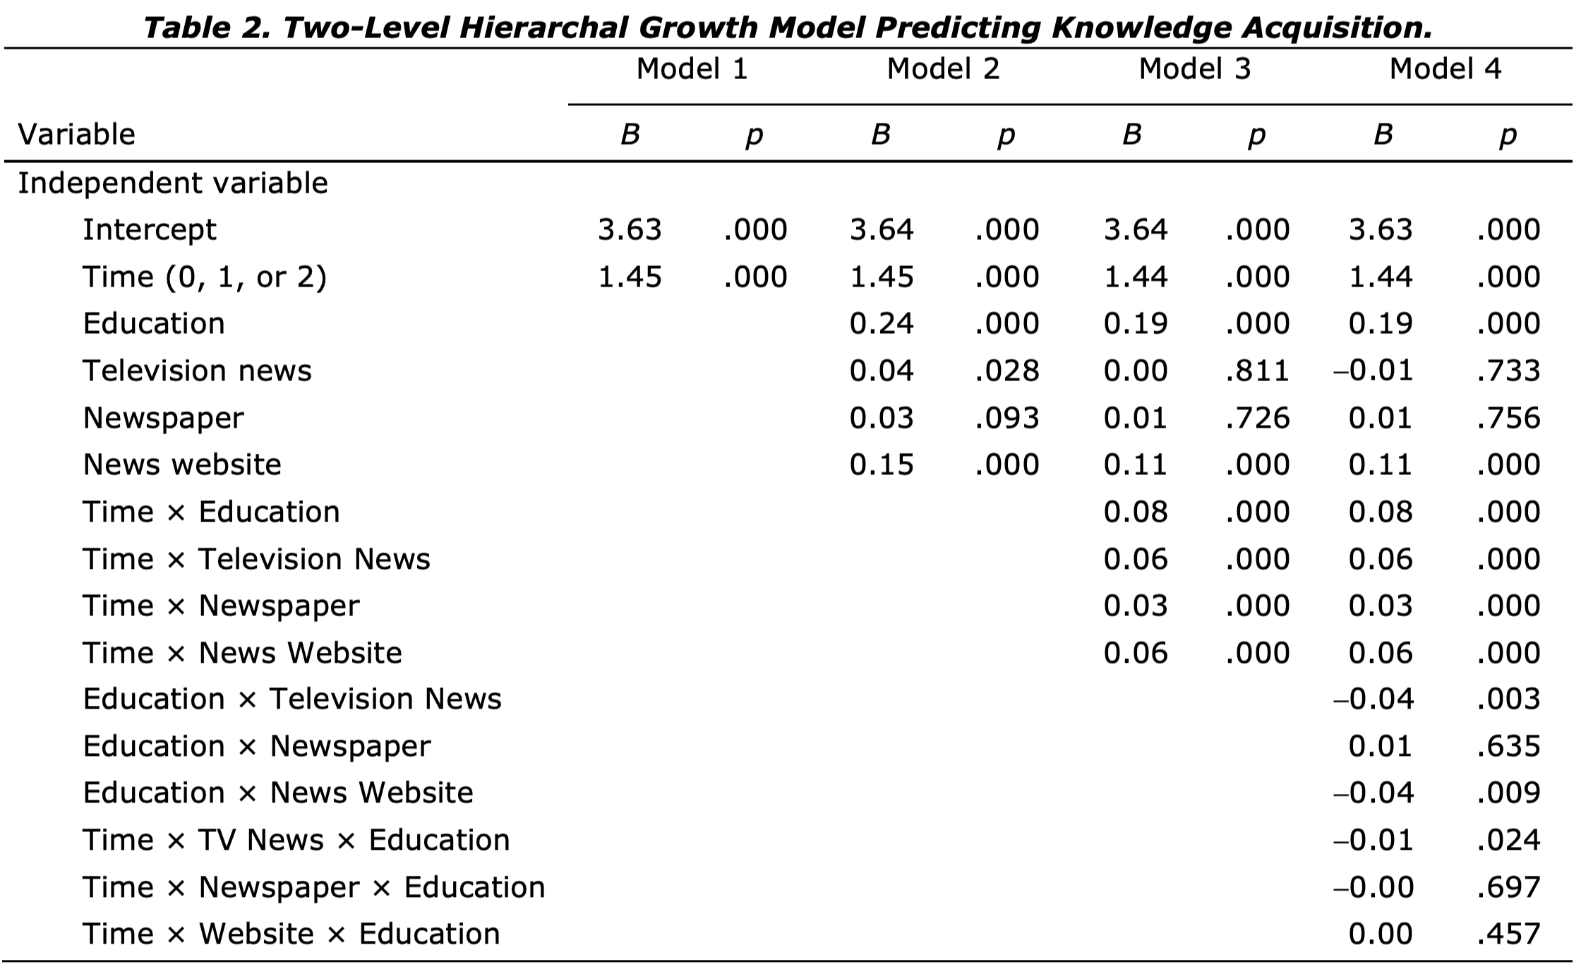
What are the main results
H1(a)
H1(b)
H1(c)
H2
H3
RQ1

Slide 16
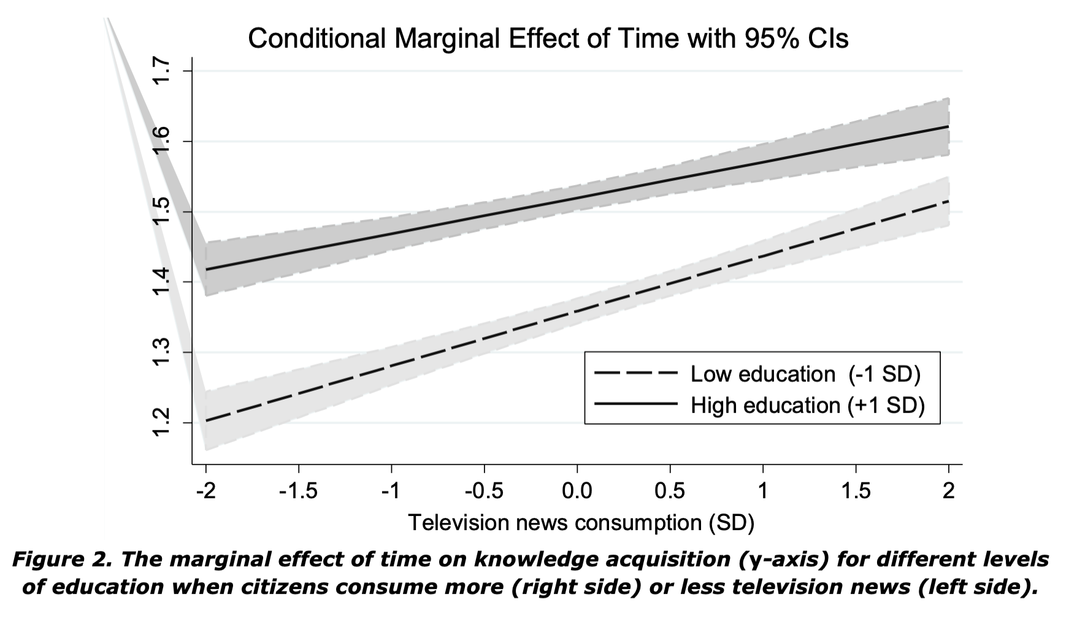
What are the main results

Slide 17
Key takeaway
News media modality matters in terms of the effects that news consumption has on the knowledge gap
When consuming more television news, knowledge acquisition increases the most for citizens with a lower level of education
Lower educated citizens benefit most from television news, which slows down the growth of a knowledge gap. Television, accordingly, lives up its potential to “bridge” the knowledge gap
Newspaper consumption neither further increases nor decreases the knowledge gap
The (in)ability of citizens to learn from textual news has become “less of a pertinent issue” due to rising education levels
The effect was neither found for the consumption of news websites
News presented online largely reflects the news that appears in printed outlets. Most of the news websites still present their news primarily in a textual format

